Slide 1
XML Assignment
- Pavithran S

Slide 2
Questions
First xml: <geodata> <person name="tom"> <address>2344 States Drive, MA 01213, USA</address> <phonenumber>333-222-2222</phonenumber> </person> <person name="mat"> <address>2345 Gates Drive, PA 11213, USA</address> <phonenumber>444-222-2222</phonenumber> </person> </geodata> Second xml: <salarydata> <person name="mat"> <salary>$3000</salary> <pension>$500</pension> </person> <person name="tom"> <salary>$3500</salary> <pension>$700</pension> </person> </salarydata>

Slide 3
Question
From the above 2 xmls, form a single xml, say persondata.xml (through a java program, that takes the above 2 files as input) that looks like this: <persondata> <person name="tom"> <address>2344 States Drive, MA 01213, USA</address> <phonenumber>333-222-2222</phonenumber> <salary>$3500</salary> <pension>$700</pension> </person> <person name="mat">
<address>2345 Gates Drive, PA 11213, USA</address> <phonenumber>444-222-2222</phonenumber> <salary>$3000</salary> <pension>$500</pension> </person> </persondata>
Extract this data, using java, from the persondata.xml and store in a persondata db table. Form your own persondata table structure (keeping the above persondata.xml metadata as reference). The db is your choice (could be mysql, oracle, sql server or any relational db)
Write a html form that accepts some keywords from the user for each db field (for example, States Drive or 333 or $700) and a corresponding action servlet that searches the persondata db table and prints/echos the matching record on to the user screen (in this example case, tom's record). Pl. use relevant tools / components such as AJAX, JQuery in this exercise, wherever you think is appropriate.

Slide 4
Pre-Requisites
MySQL 8.0.25
Apache Tomcat server v9.0
IDE used:
Eclipse IDE 2012-03

Slide 5
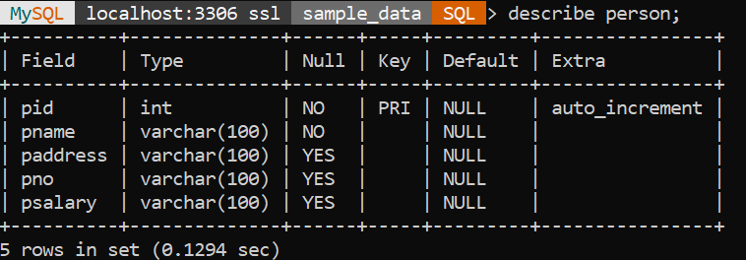
MySQL Schema

Slide 6
Merge and Store
Run ‘XmlMerge.java’ to merge two xml files.
The two files are located in the path ‘src/main/resources’.
You can change the paths in ‘XmlData.java’.
After executing, It will create a ‘persondata.xml’ and stores the data in database.

Slide 7
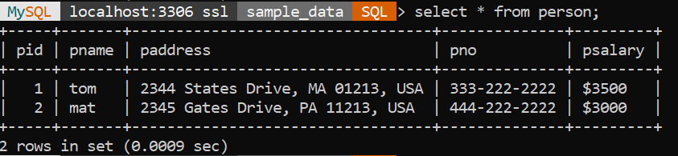
DB Data

Slide 8
Search Application
Deploy the Application on Tomcat Server.
Goto ‘http://localhost:8080/XmlAssignment/index.jsp’ url.
Enter the fields.
Result table will contains corresponding relevant records.

Slide 9
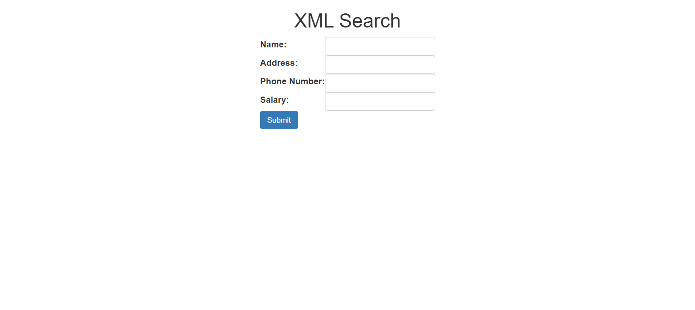

Slide 10
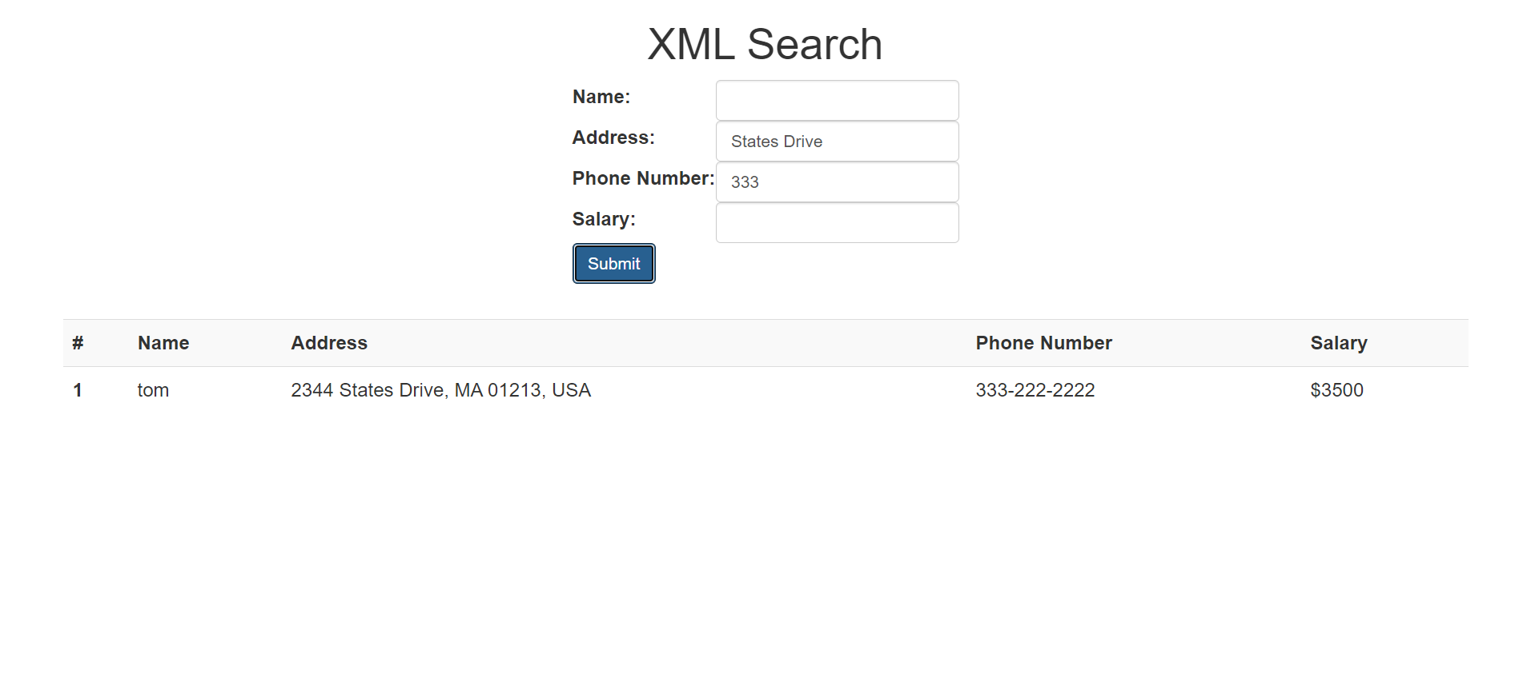

Slide 11
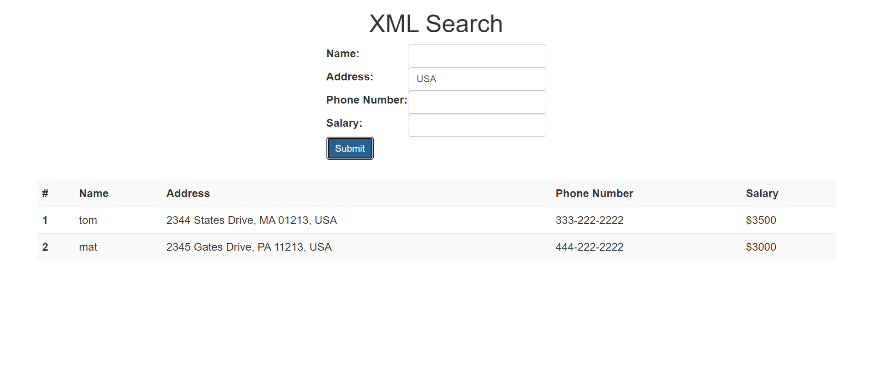

Slide 12
Thank You

